Slide 1
Four week at Green Fox
Márton Lőrinczi
2017.05.26

Slide 2
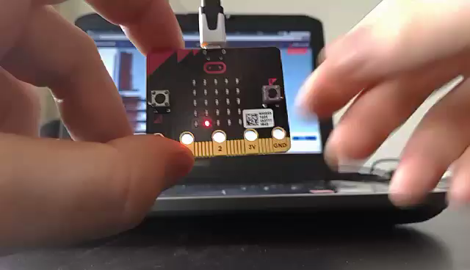
First week: Micro:Bit

Slide 3


Slide 4
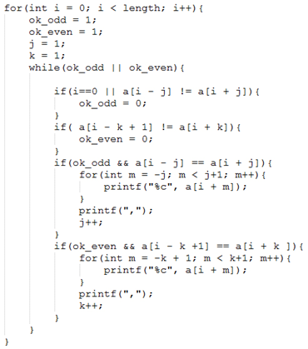

Slide 5
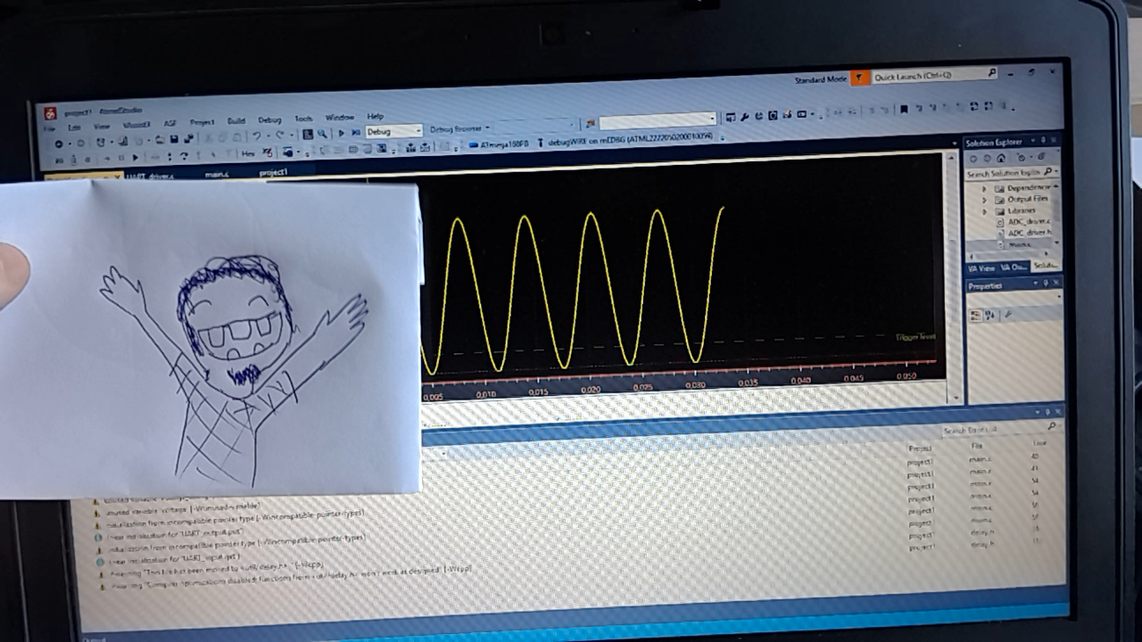

Slide 6




